Slide 1
Lecture-13

Slide 2
Contents
Devops Build Stage
Build Tools
Build Tools List
Apache Maven
Maven Architecture
Project Object Model

Slide 3
Devops Build Stage
The Build stage is the point where we take the provided code and build it for testing purposes. The code gets built in a development environment to allow for testing and bug fixes.
After the newly written code has been merged with the shared repository, developers run a series of automated tests. In a typical scenario, the pull request initiates an automated process that compiles the code into a build - a deployable package or an executable.

Slide 4
DevOps Build Stage (Cont.)
Keep in mind that some programming languages don't need to be compiled. For example, applications written in Java and C or C++ need to be compiled to run, while those written in PHP and Python do not.
If there is a problem with the code, the build fails, and the developer is notified of the issues. If that happens, the initial pull request also fails.
Developers repeat this process every time they submit to the shared repository to ensure only error-free code continues down the pipeline.

Slide 5
Build Tools
Build tools are commonly known as programs that automate the process of building an executable application from source code.
This building process includes activities like compiling, linking and packaging the code into an executable form.

Slide 6
Build Tools List
Apache Maven
Apache Ant
Gradle
Terraform
And many more…

Slide 7
What do build tools do?
Build tools facilitate a wide variety of build automation tasks, including:
  Generates source code
  Generates documentation from the source code
  Compiling : Compiling source code into machine code (0 1)
  Dependency management: Identifying and patching necessary third party integrations
  Automated tests: Executing tests and reporting failure
  Packaging app for deployment: Prepares source code for deployment to servers
  Packages compiled code into JAR or WAR of ZIP file
  Installs the packaged code in local repository, server repository, or central repository

Slide 8
Build Tools Google Trends
https://trends.google.com/trends/explore?q=%2Fm%2F04tj5z,%2Fm%2F028m4s,%2Fm%2F080c0g9,%2Fg%2F11g6bg27fp

Slide 9

Maven
Maven is a powerful automation and project management tool, is developed by Apache software foundation that is based on POM (project object model).
It is a Java-based build tool, it supports projects built written in other programming languages.
It is used for projects build, dependency and documentation.
Maven is an Apache open-source project.

Slide 10
Maven (Cont.)
It uses XML to configure projects and Java to write extensions.
Maven projects are primarily defined by Project Object Model (POM) files written in XML.
Current version of Apache Maven is 3.8.5
System Requirements
Java Development Kit (JDK): Maven 3.3+ require JDK 1.7 or above to execute

Slide 11
Maven Architecture
The projects created in Maven contain POM files that describe the aspect of the project essentials.
Maven architecture shows the process of creating and generating a report according to the requirements and executing lifecycles, phases, goals, plugins, and so on—from the first step.

Slide 12
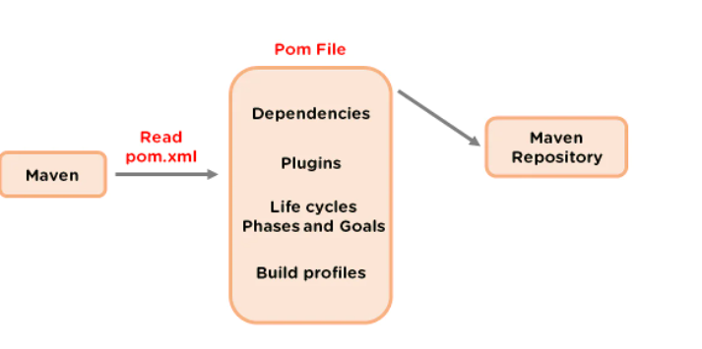
Maven Architecture (Cont.)
GitHub
Source Code

Slide 13
How Does the Maven Architecture Work?
The first step refers to configuring Maven, which is stored in a pom.xml file
The POM file includes all of the configurations that Maven needs. The second step is to download the dependencies defined in pom.xml into the local repository from the central repository
After the user starts working in Maven, the tool provides various default settings, so there is no need to add every configuration in the pom.xml

Slide 14
Project Object Model (POM)
The pom.xml file contains information of project and configuration information for the maven to build the project such as dependencies, build directory, source directory, test source directory, plugin, goals etc.
Maven reads the pom.xml file, then executes the goal.
Before maven 2, it was named as project.xml file. But, since maven 2 (also in maven 3), it is renamed as pom.xml.

Slide 15
Elements of maven pom.xml file
Element | Description
Project | It is the root element of pom.xml file.
modelVersion | It is the sub element of project. It specifies the modelVersion. It should be set to 4.0.0.
groupId | It is the sub element of project. It specifies the id for the project group.
artifactId | It is the sub element of project. It specifies the id for the artifact (project). An artifact is something that is either produced or used by a project. Examples of artifacts produced by Maven for a project include: JARs, source and binary distributions, and WARs.
version | It is the sub element of project. It specifies the version of the artifact under given group.

Slide 16
Elements of maven pom.xml file (Cont.)
Element | Description
packaging | defines packaging type such as jar, war etc.
name | defines name of the maven project.
url | defines url of the project.
dependencies | defines dependencies for this project.
dependency | defines a dependency. It is used inside dependencies.
scope | defines scope for this maven project. It can be compile, provided, runtime, test and system.

Slide 17
Ant vs Maven
Ant and Maven both are build tools provided by Apache. The main purpose of these technologies is to ease the build process of a project.

Slide 18
Ant vs Maven (Cont.)
Ant | Maven
Ant doesn't has formal conventions, so we need to provide information of the project structure in build.xml file. | Maven has a convention to place source code, compiled code etc. So we don't need to provide information about the project structure in pom.xml file.
Ant is procedural, you need to provide information about what to do and when to do through code. You need to provide order. | Maven is declarative, everything you define in the pom.xml file.
There is no life cycle in Ant. | There is life cycle in Maven.
It is a tool box. | It is a framework.
It is mainly a build tool. | It is mainly a project management tool.
The ant scripts are not reusable. | The maven plugins are reusable.
It is less preferred than Maven. | It is more preferred than Ant.

Slide 19
Maven Repository
A maven repository is a directory of packaged JAR file with pom.xml file.
Maven searches for dependencies in the repositories.
There are 3 types of maven repository:
  Local Repository
  Central Repository
  Remote Repository
Maven searches for the dependencies in the following order:
  Local repository then Central repository then Remote repository.

Slide 20
Maven Local Repository
Maven local repository is located in your local system. It is created by the maven when you run any maven command.
By default, maven local repository is %USER_HOME%/.m2 directory. For example: C:\Users\SSS IT\.m2.

Slide 21
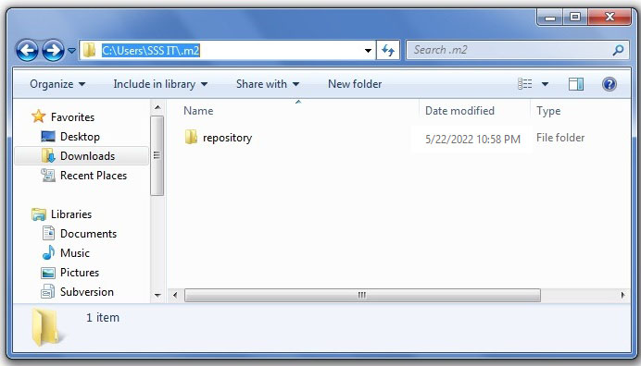
Maven Local Repository (Cont.)

Slide 22
Maven Local Repository (Cont.)
Update location of Local Repository
We can change the location of maven local repository by changing the settings.xml file. It is located in MAVEN_HOME/conf/settings.xml, for example: E:\apache-maven-3.1.1\conf\settings.xml.
Let's see the default code of settings.xml file.

Slide 23
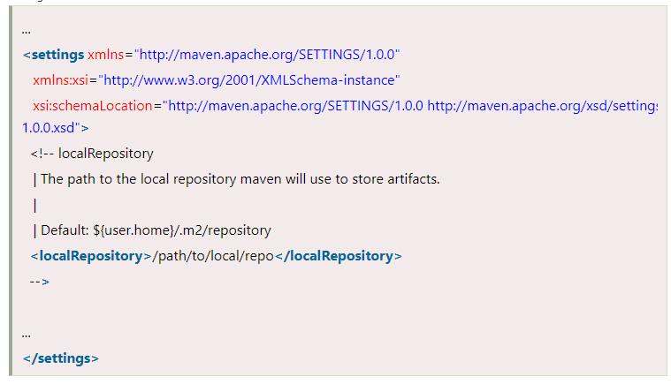
Maven Local Repository (Cont.)
Now change the path to local repository. After changing the path of local repository change.

Slide 24
Maven Central Repository
Maven central repository is located on the web. It has been created by the apache maven community itself.
The path of central repository is: http://repo1.maven.org/maven2/
The central repository contains a lot of common libraries that can be viewed by this url http://search.maven.org/#browse

Slide 25
Maven Remote Repository
Maven remote repository is located on the web. Most of libraries can be missing from the central repository such as JBoss library etc, so we need to define remote repository in pom.xml file.
Let's see the code to add the jUnit library in pom.xml file.

Slide 26
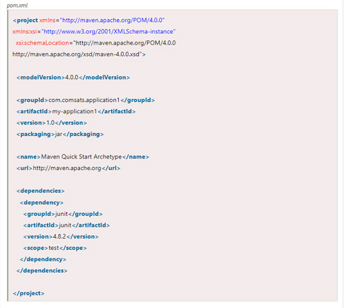
Maven Remote Repository (Cont.)

Slide 27
How to install Maven on windows
You can download and install maven on windows, linux and MAC OS platforms. Here, we are going to learn how to install maven on windows OS.
To install maven on windows, you need to perform following steps:
  Download maven and extract it
  Add JAVA_HOME and MAVEN_HOME in environment variable
  Add maven path in environment variable
  Verify Maven

Slide 28
Download Maven
To install maven on windows, you need to download apache maven first.
Download Maven latest Maven software from
  https://maven.apache.org/download.cgi
For example: apache-maven-3.8.5-bin.zip

Slide 29
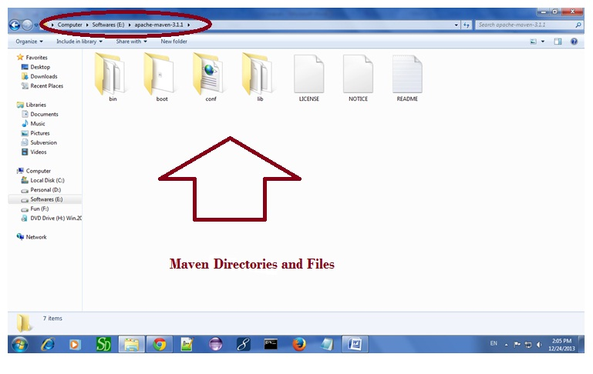
Extract it. Now it will look like this:

Slide 30
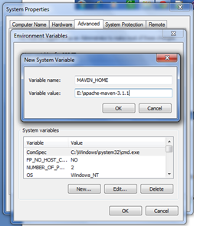
Add MAVEN_HOME in environment variable
Right click on MyComputer -> properties -> Advanced System Settings -> Environment variables -> click new button
Now add MAVEN_HOME in variable name and path of maven in variable value. It must be the home directory of maven i.e. outer directory of bin. For example: E:\apache-maven-3.8.5 .It is displayed below:
Now click on OK button.

Slide 31
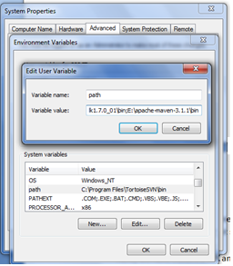
Add Maven Path in environment variable
Click on new tab if path is not set, then set the path of maven. If it is set, edit the path and append the path of maven.
Here, we have installed JDK and its path is set by default, so we are going to append the path of maven.
The path of maven should be %maven home%/bin. For example, E:\apache-maven-3.8.5\bin .
Now click on OK button.

Slide 32
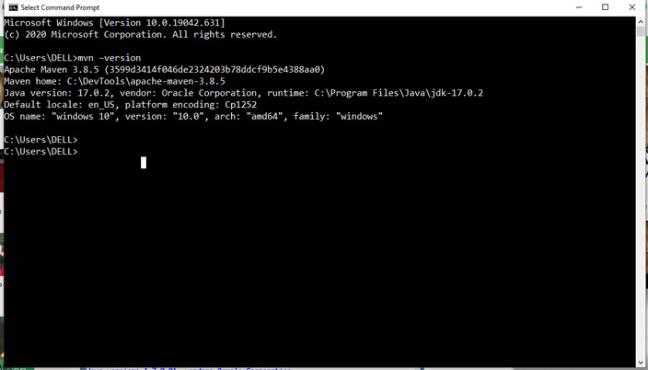
Verify maven
To verify whether maven is installed or not, open the command prompt and write:
mvn −version

Slide 33
Thanks
…?

